Slide 1
Exploratory Analysis on
Car Insurance dataset
By Murtaza Nipplewala, Delice Ndaie

Slide 2
Dataset information
Number of instances: 12,873
Number of attributes : 8 { 5 numeric and 3 nominal}
Attributes summary:
- Type: type of insurance {5 levels (A-E)}
- Gender: gender of driver {F/M}
- Vage: vehicle age {10 levels}
- Age: driver’s age {18 to 70}
- Ageg: driver’s age groups {7 levels}
1 means 0~20
2 means 21~25
3 means 26~30
4 means 31~40
5 means 41~50
6 means 51~60
7 means above 61
Region: Five US states {IL, IN MI, OH, WI}
Num: number of claims
Cost : accumulated amount of indemnity

Slide 3
Visualization Questions
What is the data distribution over the type of insurance ?
What is the data distribution over the regions?
What is the data distribution over the genders?
What is the data distribution by gender over vehicle age?
What is the data distribution of gender over age-groups?
What is the data distribution of regions over age-groups?

Slide 4
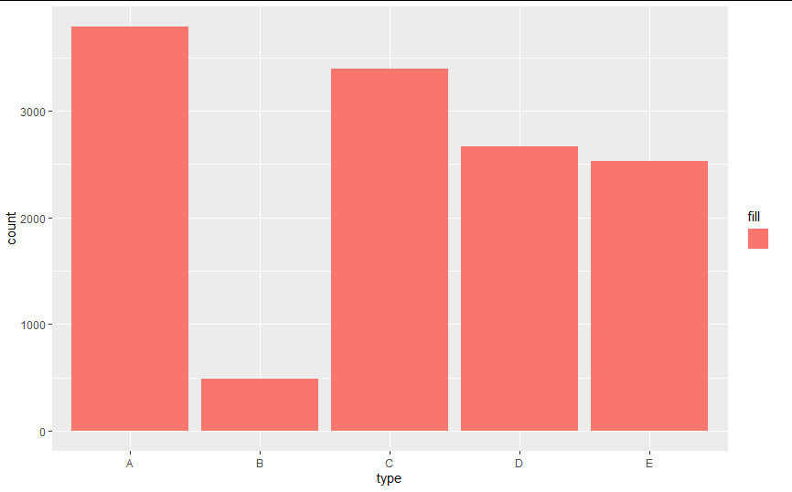
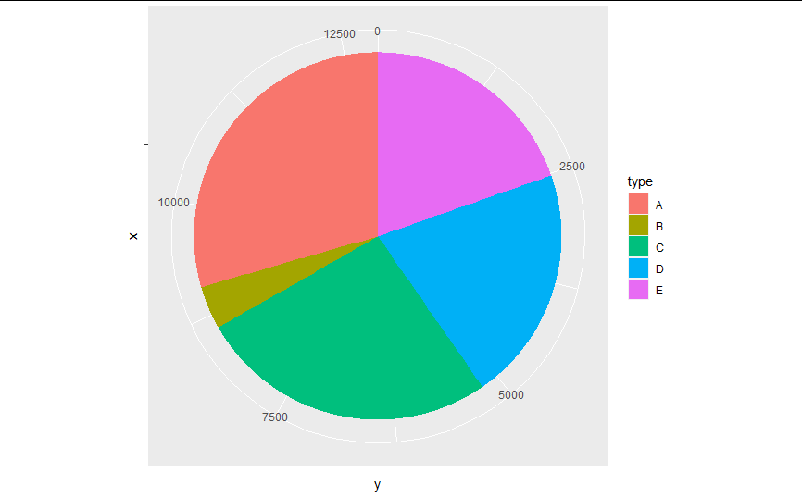
Data distribution of “type” attribute
(types of insurance)

Slide 5
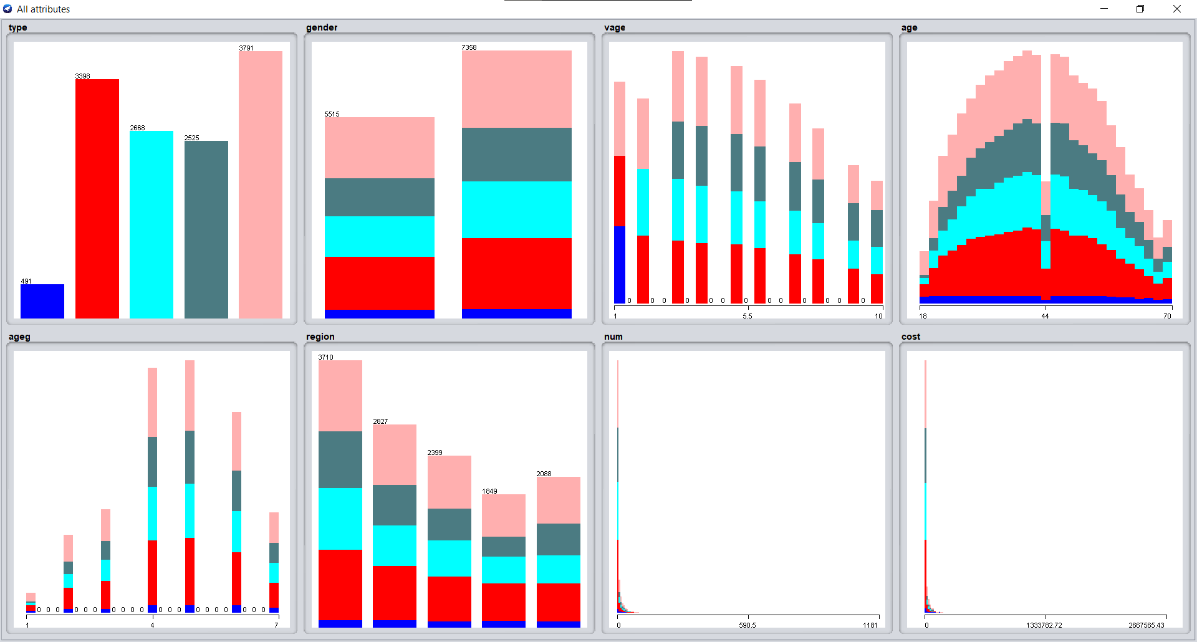
Data distribution of type over entire dataset
Type B
Type C
Type D
Type E
Type A
Notes:
B C D E A

Slide 6
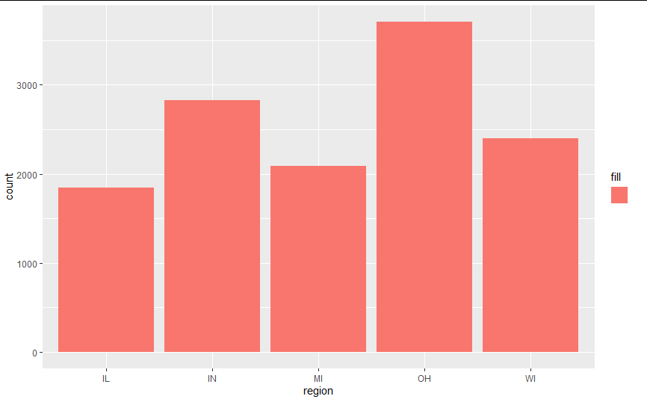
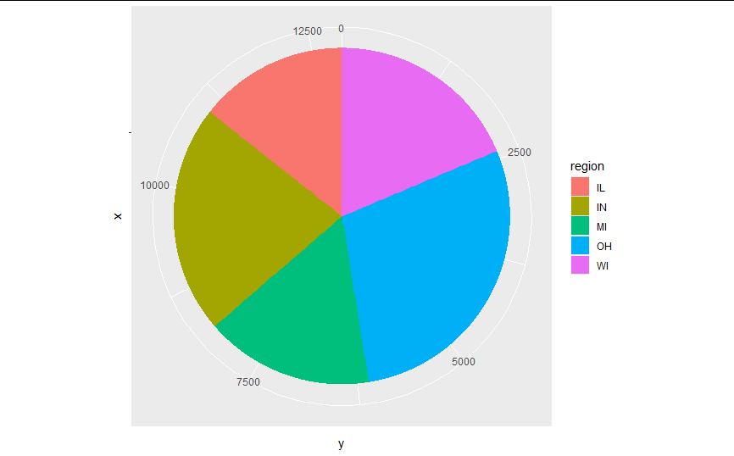
Data distribution of “region” attribute

Slide 7
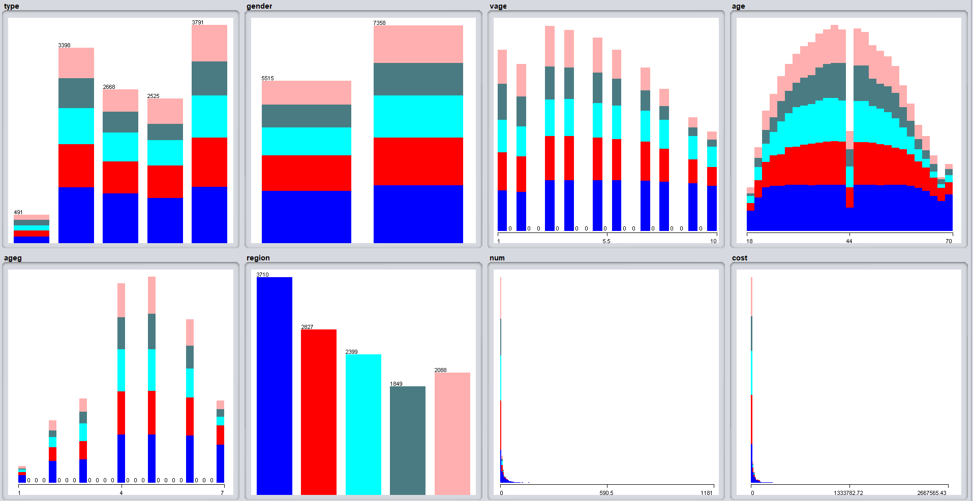
Data distribution of “region” over entire dataset
OHIO
INDIANA
WISCONSIN
ILLINOIS
MICHIGAN

Slide 8
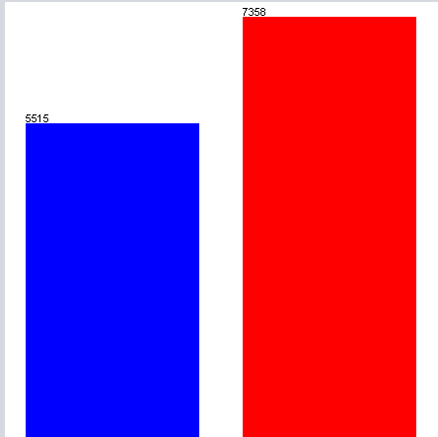
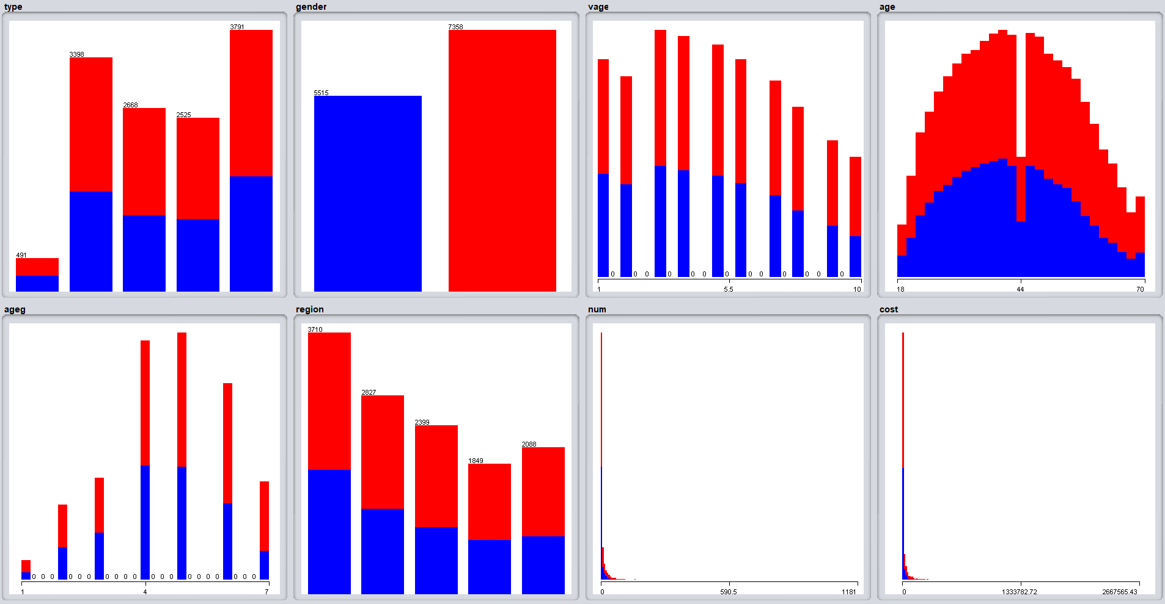
Data distribution of “gender” over entire dataset
FEMALE
MALE

Slide 9
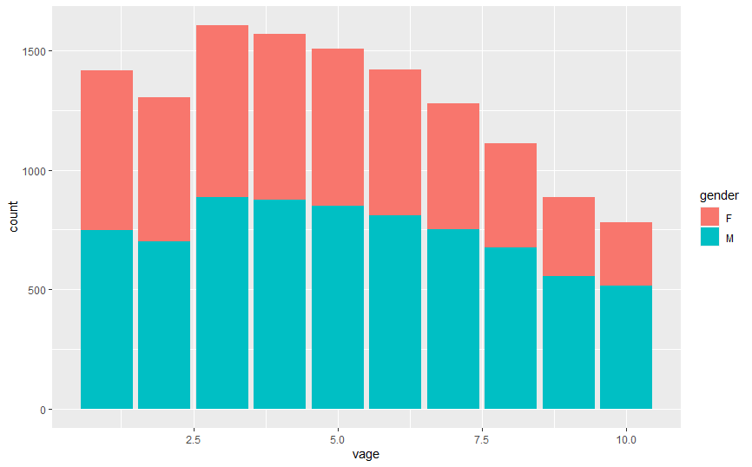
Data distribution of Gender over Vehicle-Age

Slide 10
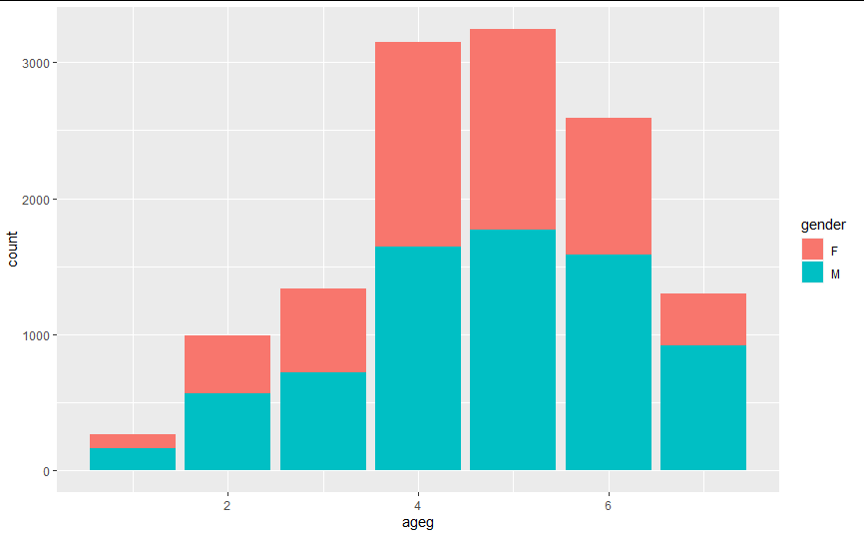
Data distribution of gender over age-groups

Slide 11
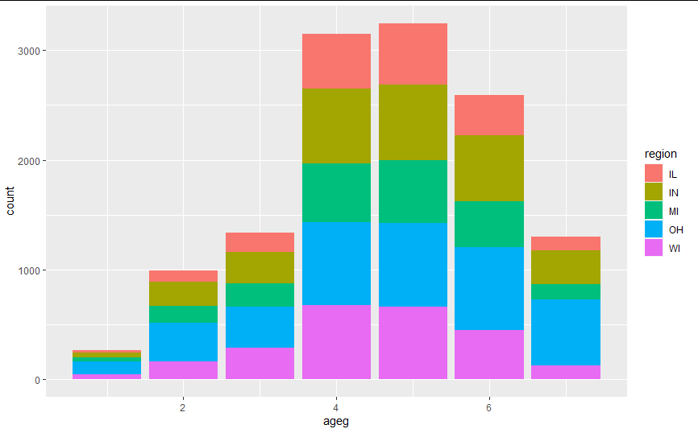
Data distribution of regions over age-groups

Slide 12
Statistical Analysis on Dataset
Do a 5 number statistical analysis on cost of insurance
Do a 5 number statistical analysis on age
What is the correlation between cost of insurance and number of claims?
What is the correlation between age-groups and number of claims/vehicle-age?

Slide 13
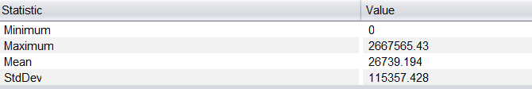
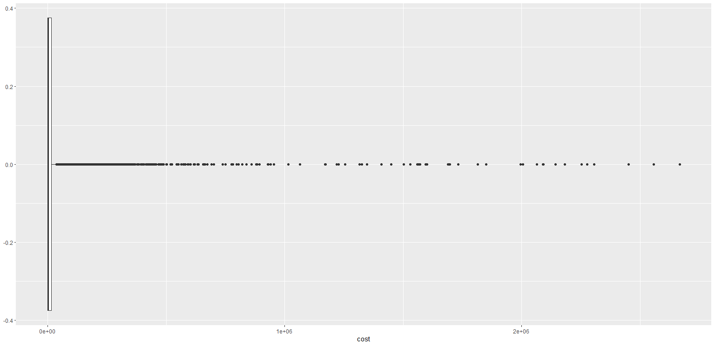
Statistical analysis on Cost of Indemnity
Minimum: 0
1st Quartile: 0
Median:2762
Mean: 26739
3rd Quartile:14445
Maximum: 2667565

Slide 14
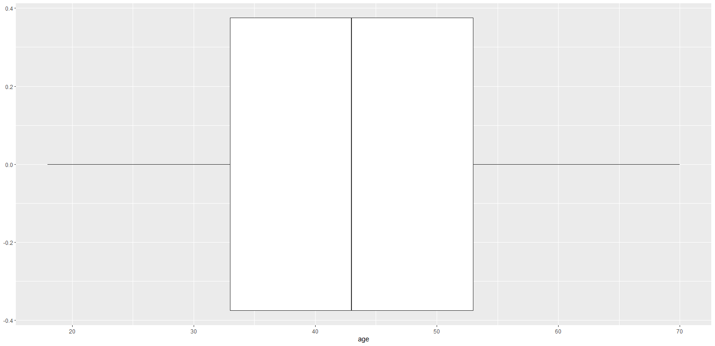
Statistical analysis on age of the driver
Minimum: 18.00
1st Quartile: 33.00
Median:43.00
Mean: 42.89
3rd Quartile: 53.00
Maximum: 70.00

Slide 15
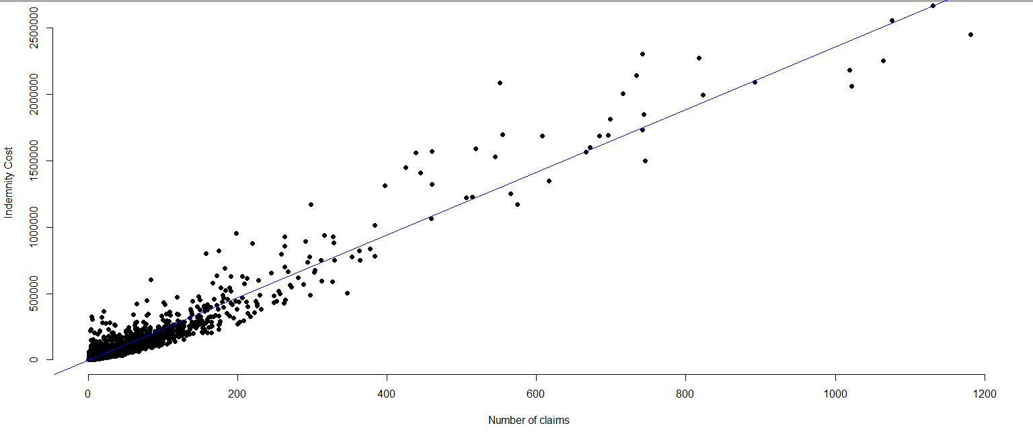
Correlation between cost of indemnity and number of claims
Correlation number: 0.9667875
Meaning: cost of indemnity and numbers of claims are relatively close to linear dependency. They are strongly connected.

Slide 16
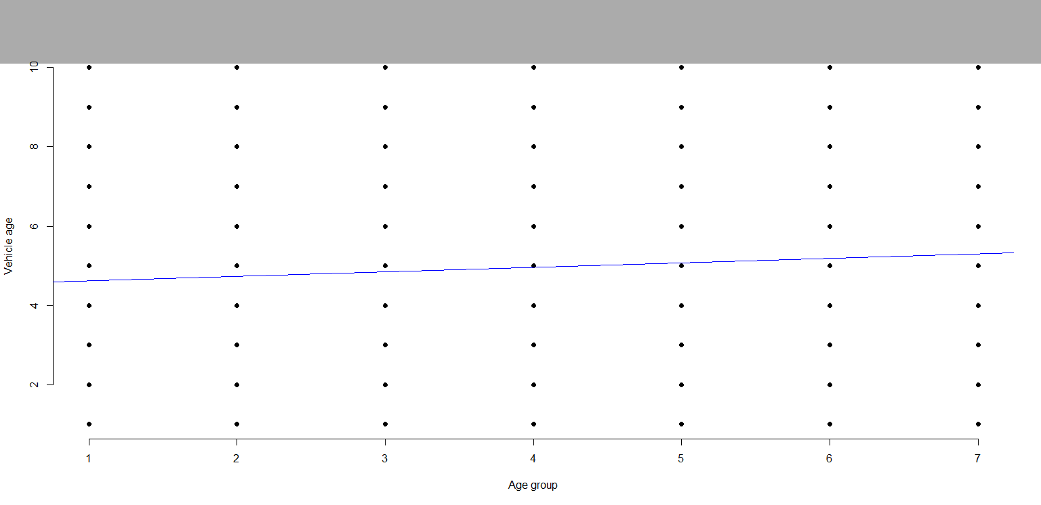
Correlation between age-groups and vehicle age
Correlation number: 0.06115093
Meaning: age-groups and vehicle age of claims probably have the weakest linear dependency

Slide 17
Relevant Data Mining Questions
Cluster data with respect to the type of insurance based on age of driver, vehicule age, num of claims and cost of insurance.
Can you predict the type of insurance based on the region and the gender?
Can you predict the type of insurance based on the vehicle-age, age of driver, num of claims and cost of insurance?
How is type, gender and region associated with each other?

Slide 18
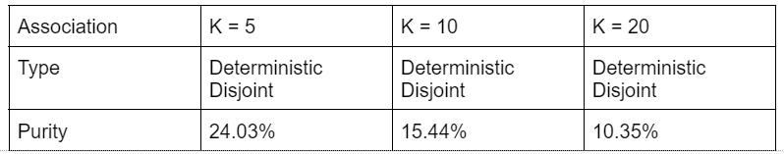
Data association of age, vehicle age, number of claims and cost of insurance over type of insurance Using SimpleKmeans
Normally, purity increases as no. of cluster increases but in our case it’s the opposite.

Slide 19
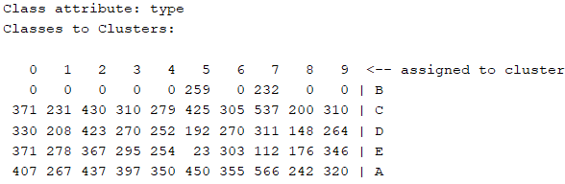
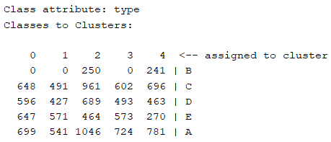
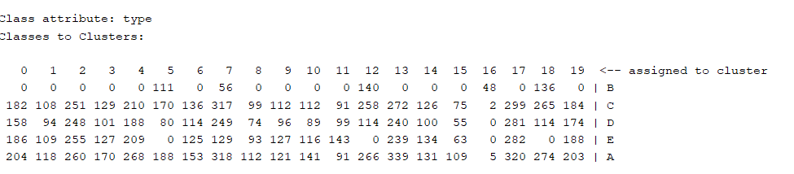
Confusion matrix of cluster 5, 10 and 20

Slide 20
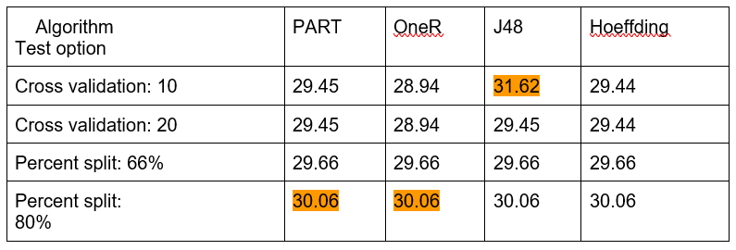
Prediction of region and gender over type of insurance

Slide 21
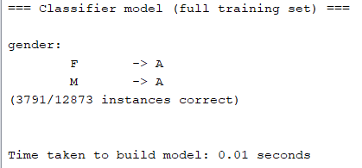
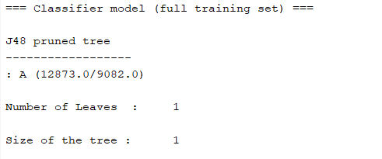
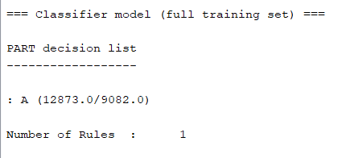
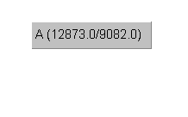
Rules and Tree of Algorithms with best accuracy
OneR Rules List:

Slide 22
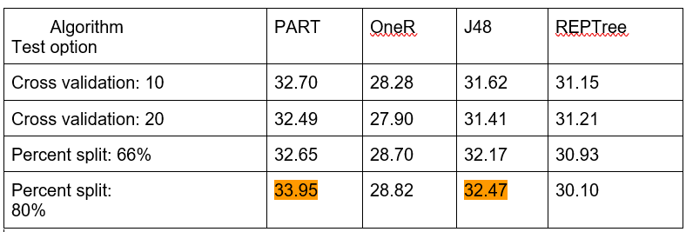
Prediction of age, vehicle age, number of claims and cost over type of insurance

Slide 23
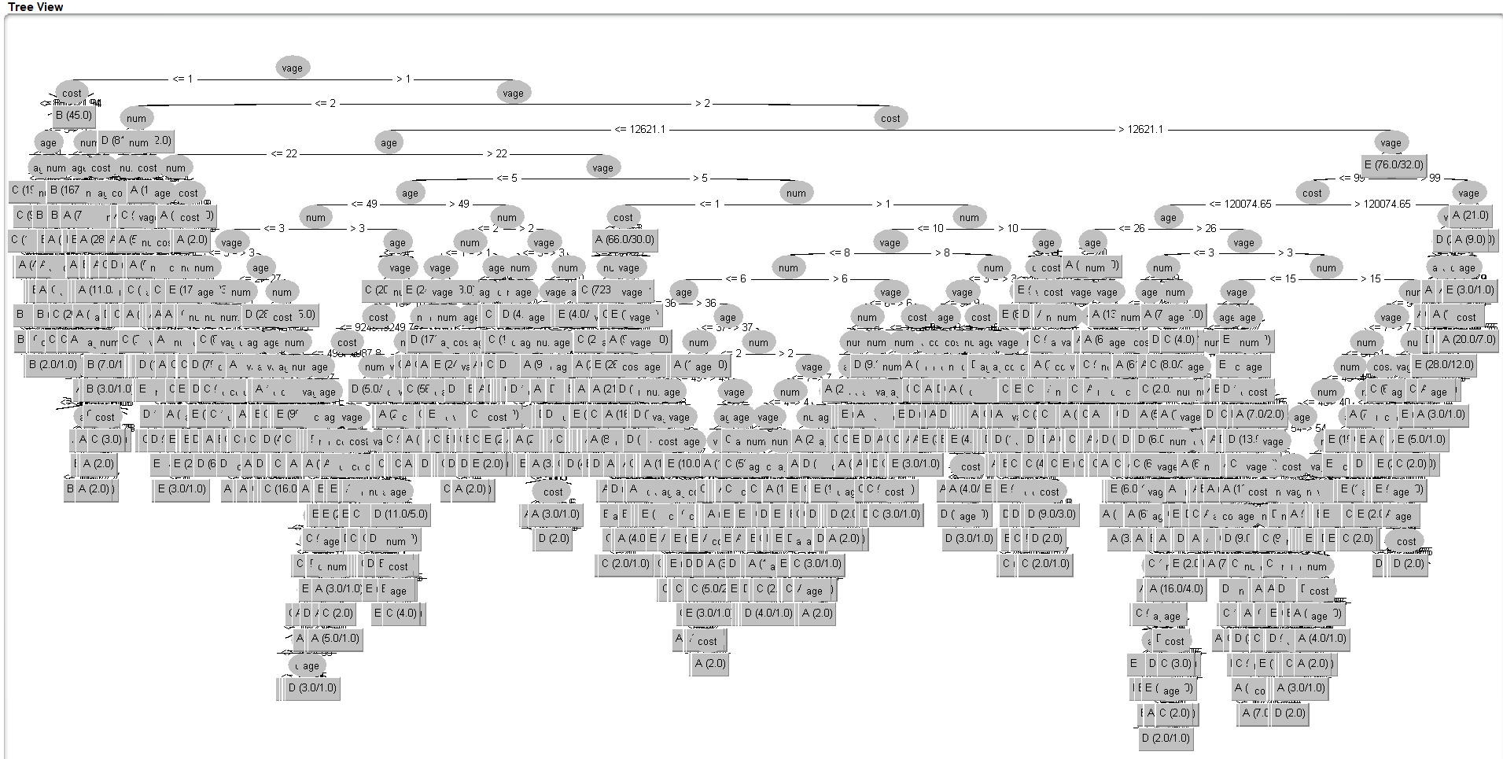

PART Decision list with best accuracy - 123 Rules
Tree visualization of J48 with best accuracy

Slide 24
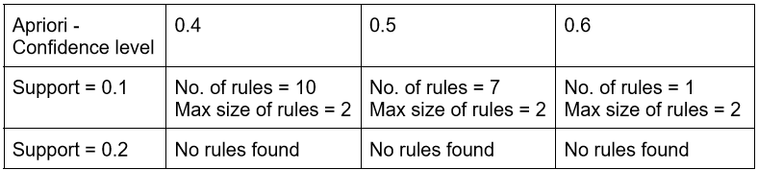
Association between type of insurance, gender and region

Slide 25
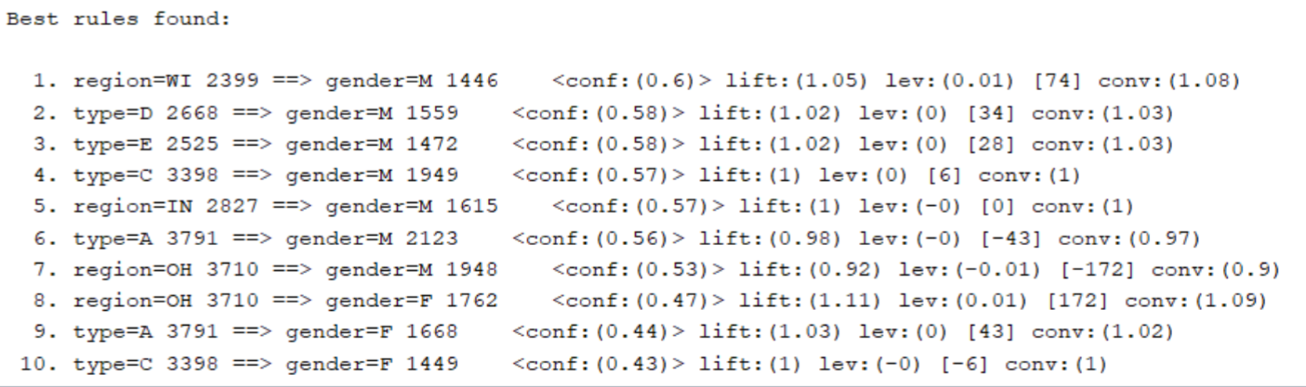
Rules at confidence 0.4 and support 0.1

Slide 26
If we had more time
More correlation questions:
Correlation between number of claims and vehicle age
Correlation between number of claims and type of insurance
Correlation between type of insurance and cost of indemnity
More Data mining questions:
Prediction of no. of claims and cost over gender
Prediction of no. of claims and cost over region
Run more algorithms with different testing methods
Using Random tree

Slide 27
Tools and Sources
Resources:
R Graphics - Plotting (w3schools.com)
R Graphics - Pie (w3schools.com)
egreene/car-insurance | Workspace | data.world
Tools:
R studio
R
Weka

Slide 28
Thank you for your time!

